Slide 1

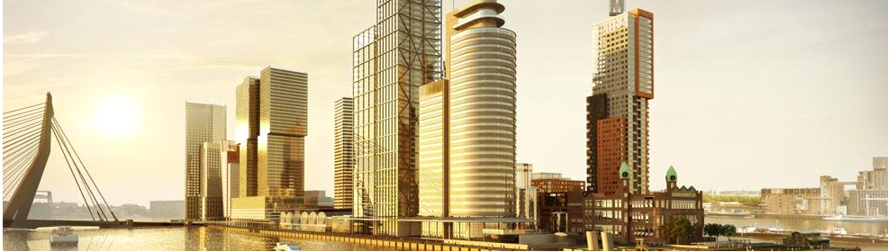

Smart Cities – an introduction
Dr. Haydee S. Sheombar
Notes:
Welcome to this introduction about Smart Cities. In this lecture we have three learning objectives.

Slide 2
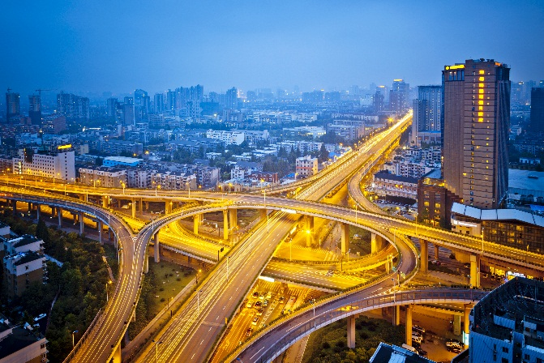

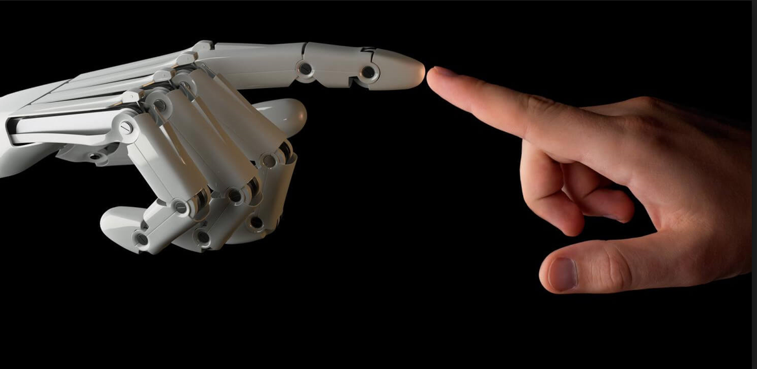
Learning objectives
What
are smart cities?
Urban Data Platforms
Ethical consi-derations
Notes:
We will first define smart cities. Then we will describe Urban data platforms as an essential part of the smart city. And finally you will get a notion of its many ethical concerns.

Slide 3
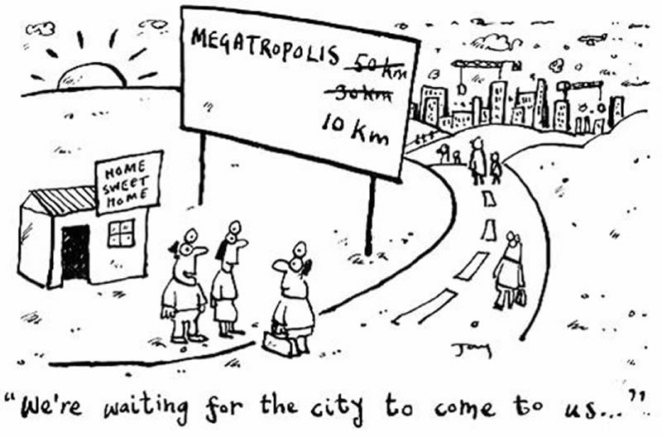

Cities account for 80% of all CO2 emissions on earth
“By 2050 about 70% of the world’s population will live in cities”
70%
47%
30%
12%
3%
1%
1800
1850
1900
1950
2000
2050
Notes:
Today about 55% of the world´s population lives in cities. The united nations predict that by 2050 the urban population will have reached 70%. Many of today’s ecological and socio-economic challenges emerge in urban areas. The tech companies that minted the term Smart Cities more than a decade ago, therefore thought that cities were a good place to start solving these problems.
SOURCE MATERIAL
Today (2018) , the most urbanized regions include Northern America (with 82% of its population living in urban areas in 2018), Latin America and the Caribbean (81%), Europe (74%) and Oceania (68%). The level of urbanization in Asia is now approximating 50%. In contrast, Africa remains mostly rural, with 43% of its population living in urban areas.
Het belang van steden neemt toe. In 2009 heeft IBM wereldwijd smarter Cities geintroduceerd. Benjamin Barber zou graag zien dat Burgemeester de wereld zouden besturen, en Edward Gleaser heeft het over de triomf van de stad. Feit is dat steden een belangrijke rol spelen in het oplossen van de multi-level complexe vraagstukken van onze tijd.

Slide 4
The first cities appeared in Mesopotamia some 6000 years ago
Civilisation comes from the Latin word “Civitas” - meaning city
© Georg Gerster National Geographic
Notes:
Let’s reflect for a minute on the fact that cities are a relatively recent human invention. The first cities emerged only 6000 years ago in Mesopotamia, when homo sapiens had been roaming the earth for already 300 thousand years. Cities come and go and their demise is caused by either natural disaster, changing economics, war, or environmental depletion. The latter was the case for Tikal, one of the great cities of Mayan civilization. Not crossing planetary boundaries is a big driver of smart cities, by using technology to protect us from a demise on an even grander scale than Tikal.

Slide 5
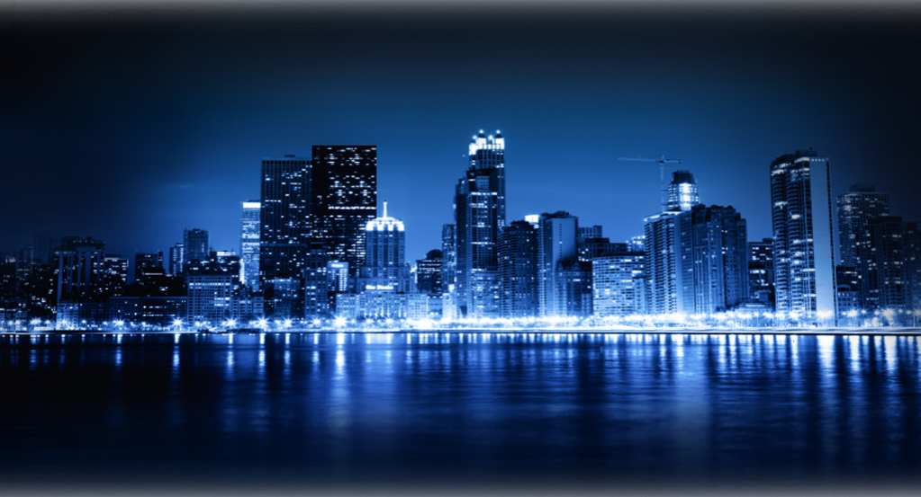

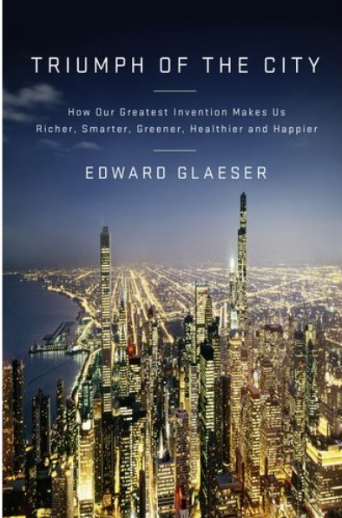
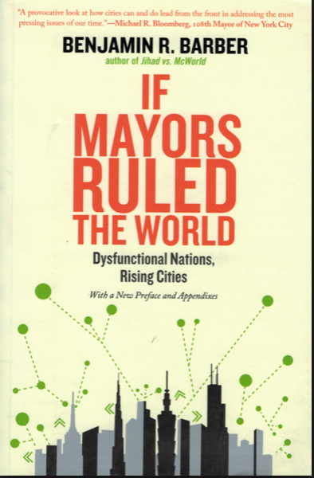
Are cities our “greatest invention” ?
“Cities are places where
ideas have sex”
“… our culture, our prosperity, and our freedom are all ultimately gifts of people living, working, and thinking together –
the ultimate triumph of the city”
“Can cities save the world? I believe they can”
Notes:
Cities have been called our greatest invention. Why in this age of ubiquitous and high bandwith tele-communications do people continue to flock to cities? Because cities are like crucibles for human ingenuity. Ingenuity that flourishes with high touch interactions, chance encounters, and scale. But, unfortunately, not only prosperity scales with the size of cities, so do adverse effects like crime, pollution and congestion.

Slide 6
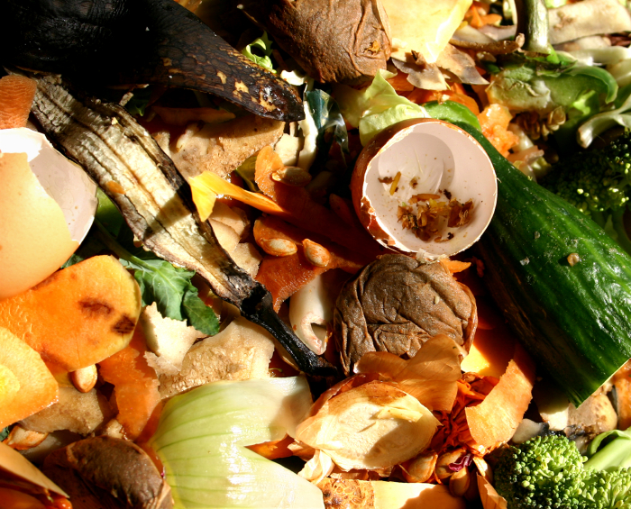
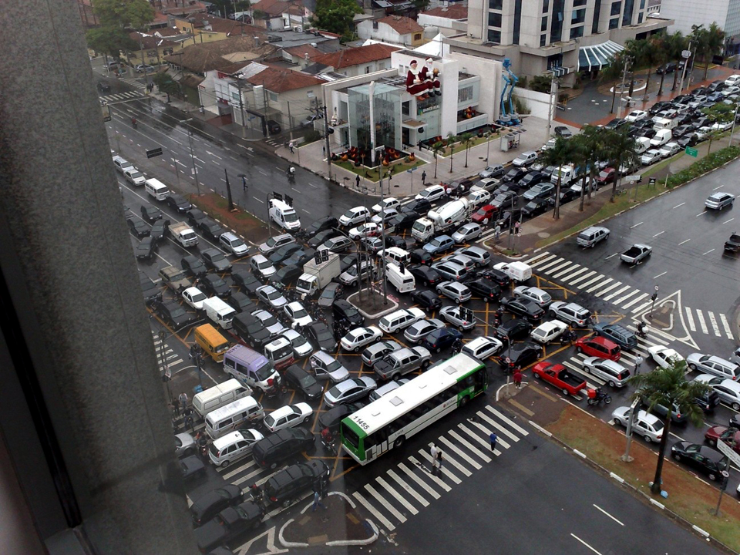
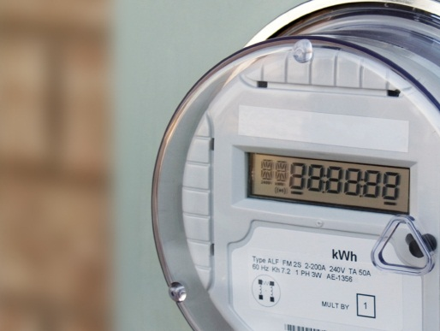

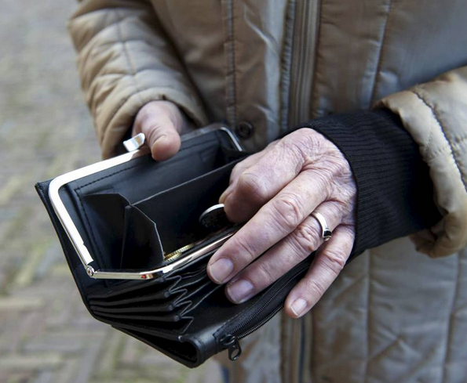
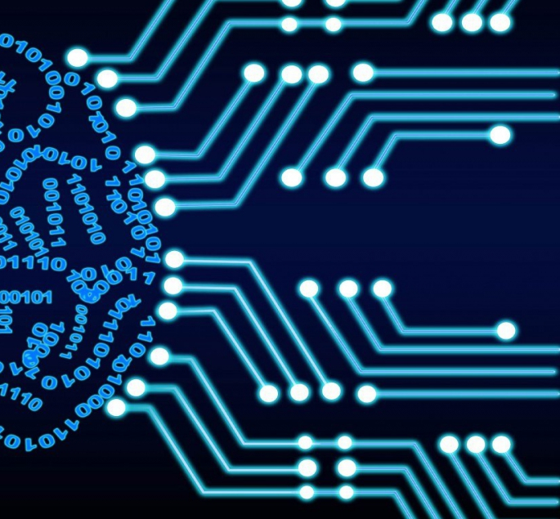
Grand
Challenges
http://www.refdag.nl/achtergrond/consument/armoede_in_nederland_1_699338
Notes:
Smart Cities can help us solve some these challenges. Grand challenges such as climate change and growing inequality. If we can collect data about the behaviour of infrastructure and people by using sensors, if we can interpret the resulting Big Data using analytics and Artificial Intelligence, then we should be able to devise actions to combat these challenges. This is the idea behind the smart city.

Slide 7
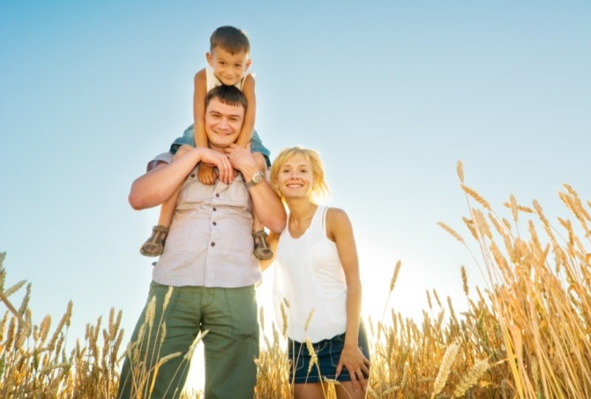
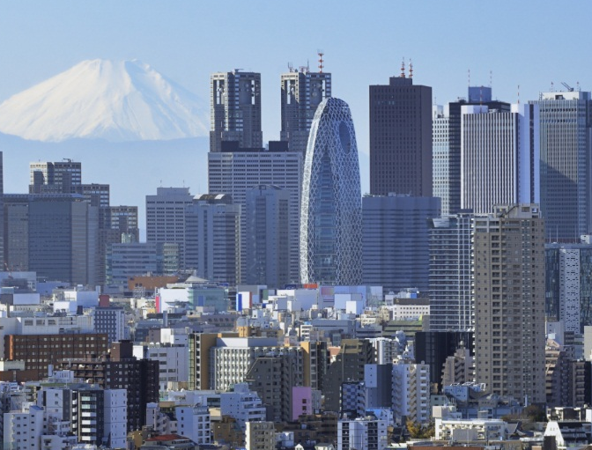

Smart Cities are about people, planet & profit
Efficient
Sustainable
Prosperous
Inclusive
Economically
And Socially Vibrant
Cost, Safety and Accessibility
Quality of Life
for all
Climate and
Environment
Cost of Infrastructure and city services
City Metabolism and Nature Preservation
Healthy and Educated Population,
Attractive for investment
Public policies,
community enagement, and democracy
Notes:
In a Smart City technology is used to improve the efficiency, sustainability, prosperity, and inclusion of the city and its citizens. A smart city is as much about smart infrastructure as it is about smart citizens. It requires the concerted action of the quadruple helix, which is the constellation of governments, companies, institutions, and citizens.

Slide 8
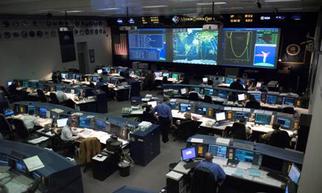
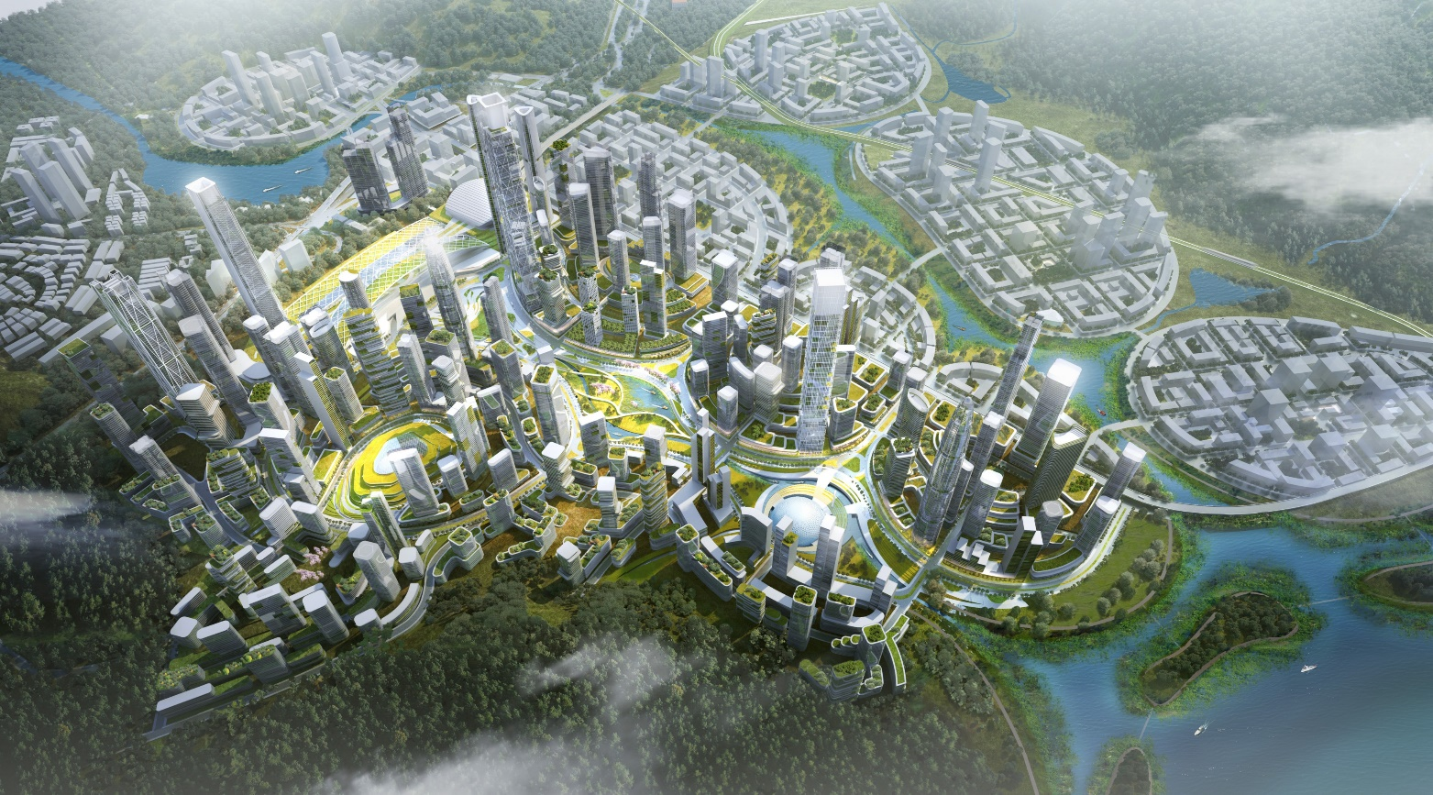

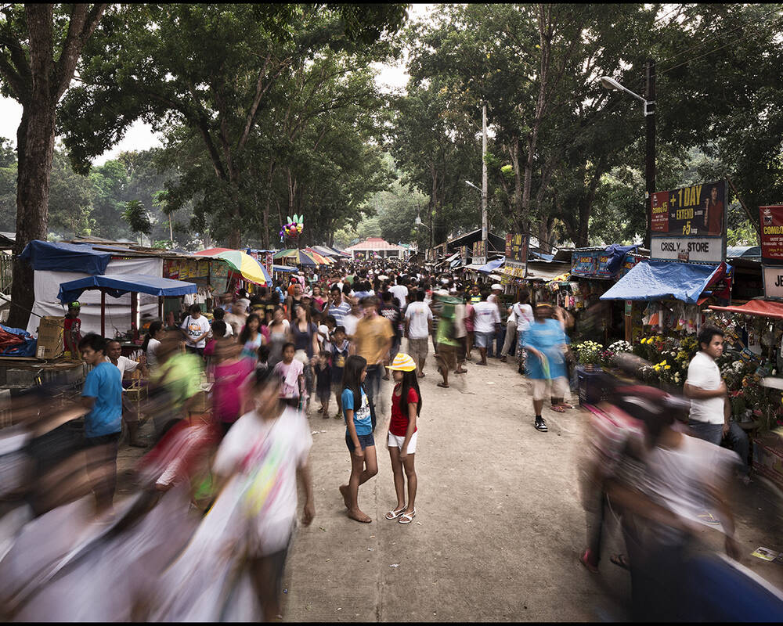
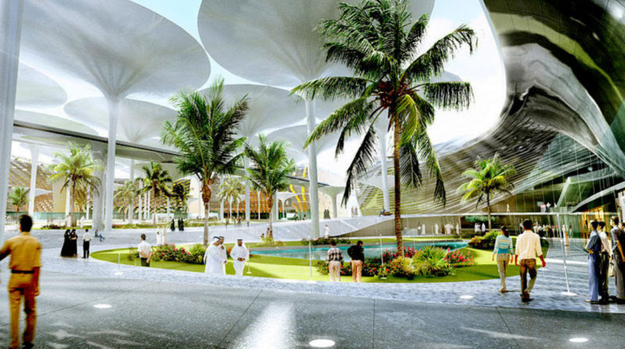

© SOM
A “mission control” for urban infrastructure Rio de Janeiro
A “future city” showcasing future urban planning concepts
[A. Scotti]
A “people-centered city”
A self-sufficient, sustainable eco-city” Masdar City
Notes:
Over the years the concept “smart city” has taken on many meanings. Some view the smart city as having an intelligent operations center to run daily operations. For many a smart city is about creating a green and resilient city. More recently UN Habitat has launched the notion of a People-centred smart city. Reminding us, that in the end, the smart city is not about technology, but about people and the way we change our behaviour.

Slide 9
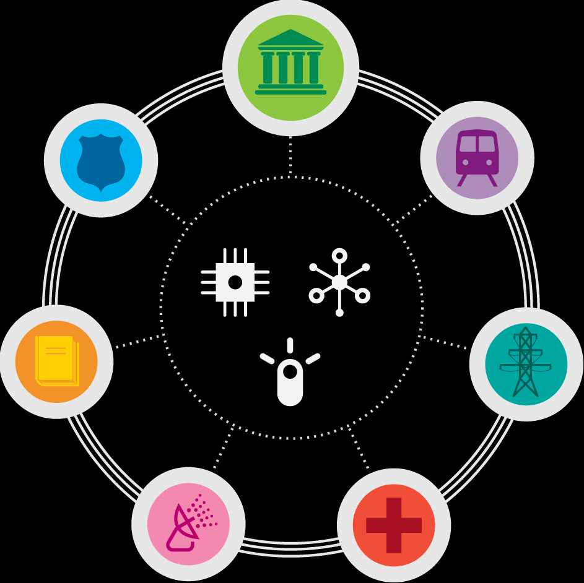




City: a bounded ‘system of systems’
Governance
Planetary
boundary
Public Safety
Mobility
Minimum
human needs & rights
Buildings, Infrastructure & resources
Energy
Safe and
just space to operate
Education
Healthy living
Inspired by IBM & Kate Raworth
Notes:
Despite their enormous diversity, cities everywhere are identical in one respect: they are all a system of systems. Webs of complex and deeply interdependent interactions between people and things across domains.
Cities that improve traffic flow, for example, will simultaneously improve emergency response. Cities that improve healthy living, will attract employers that drive economic growth. And as a last example, cities that use cameras for public safety, can use these same cameras for the maintenance of public spaces.
One key point to take away from this slide is that there is much more to the smart city than just Energy. Another point is that the smart city should help us stay within planetary boundaries, whilst catering to minimum human needs and fundamental human rights.

Slide 10
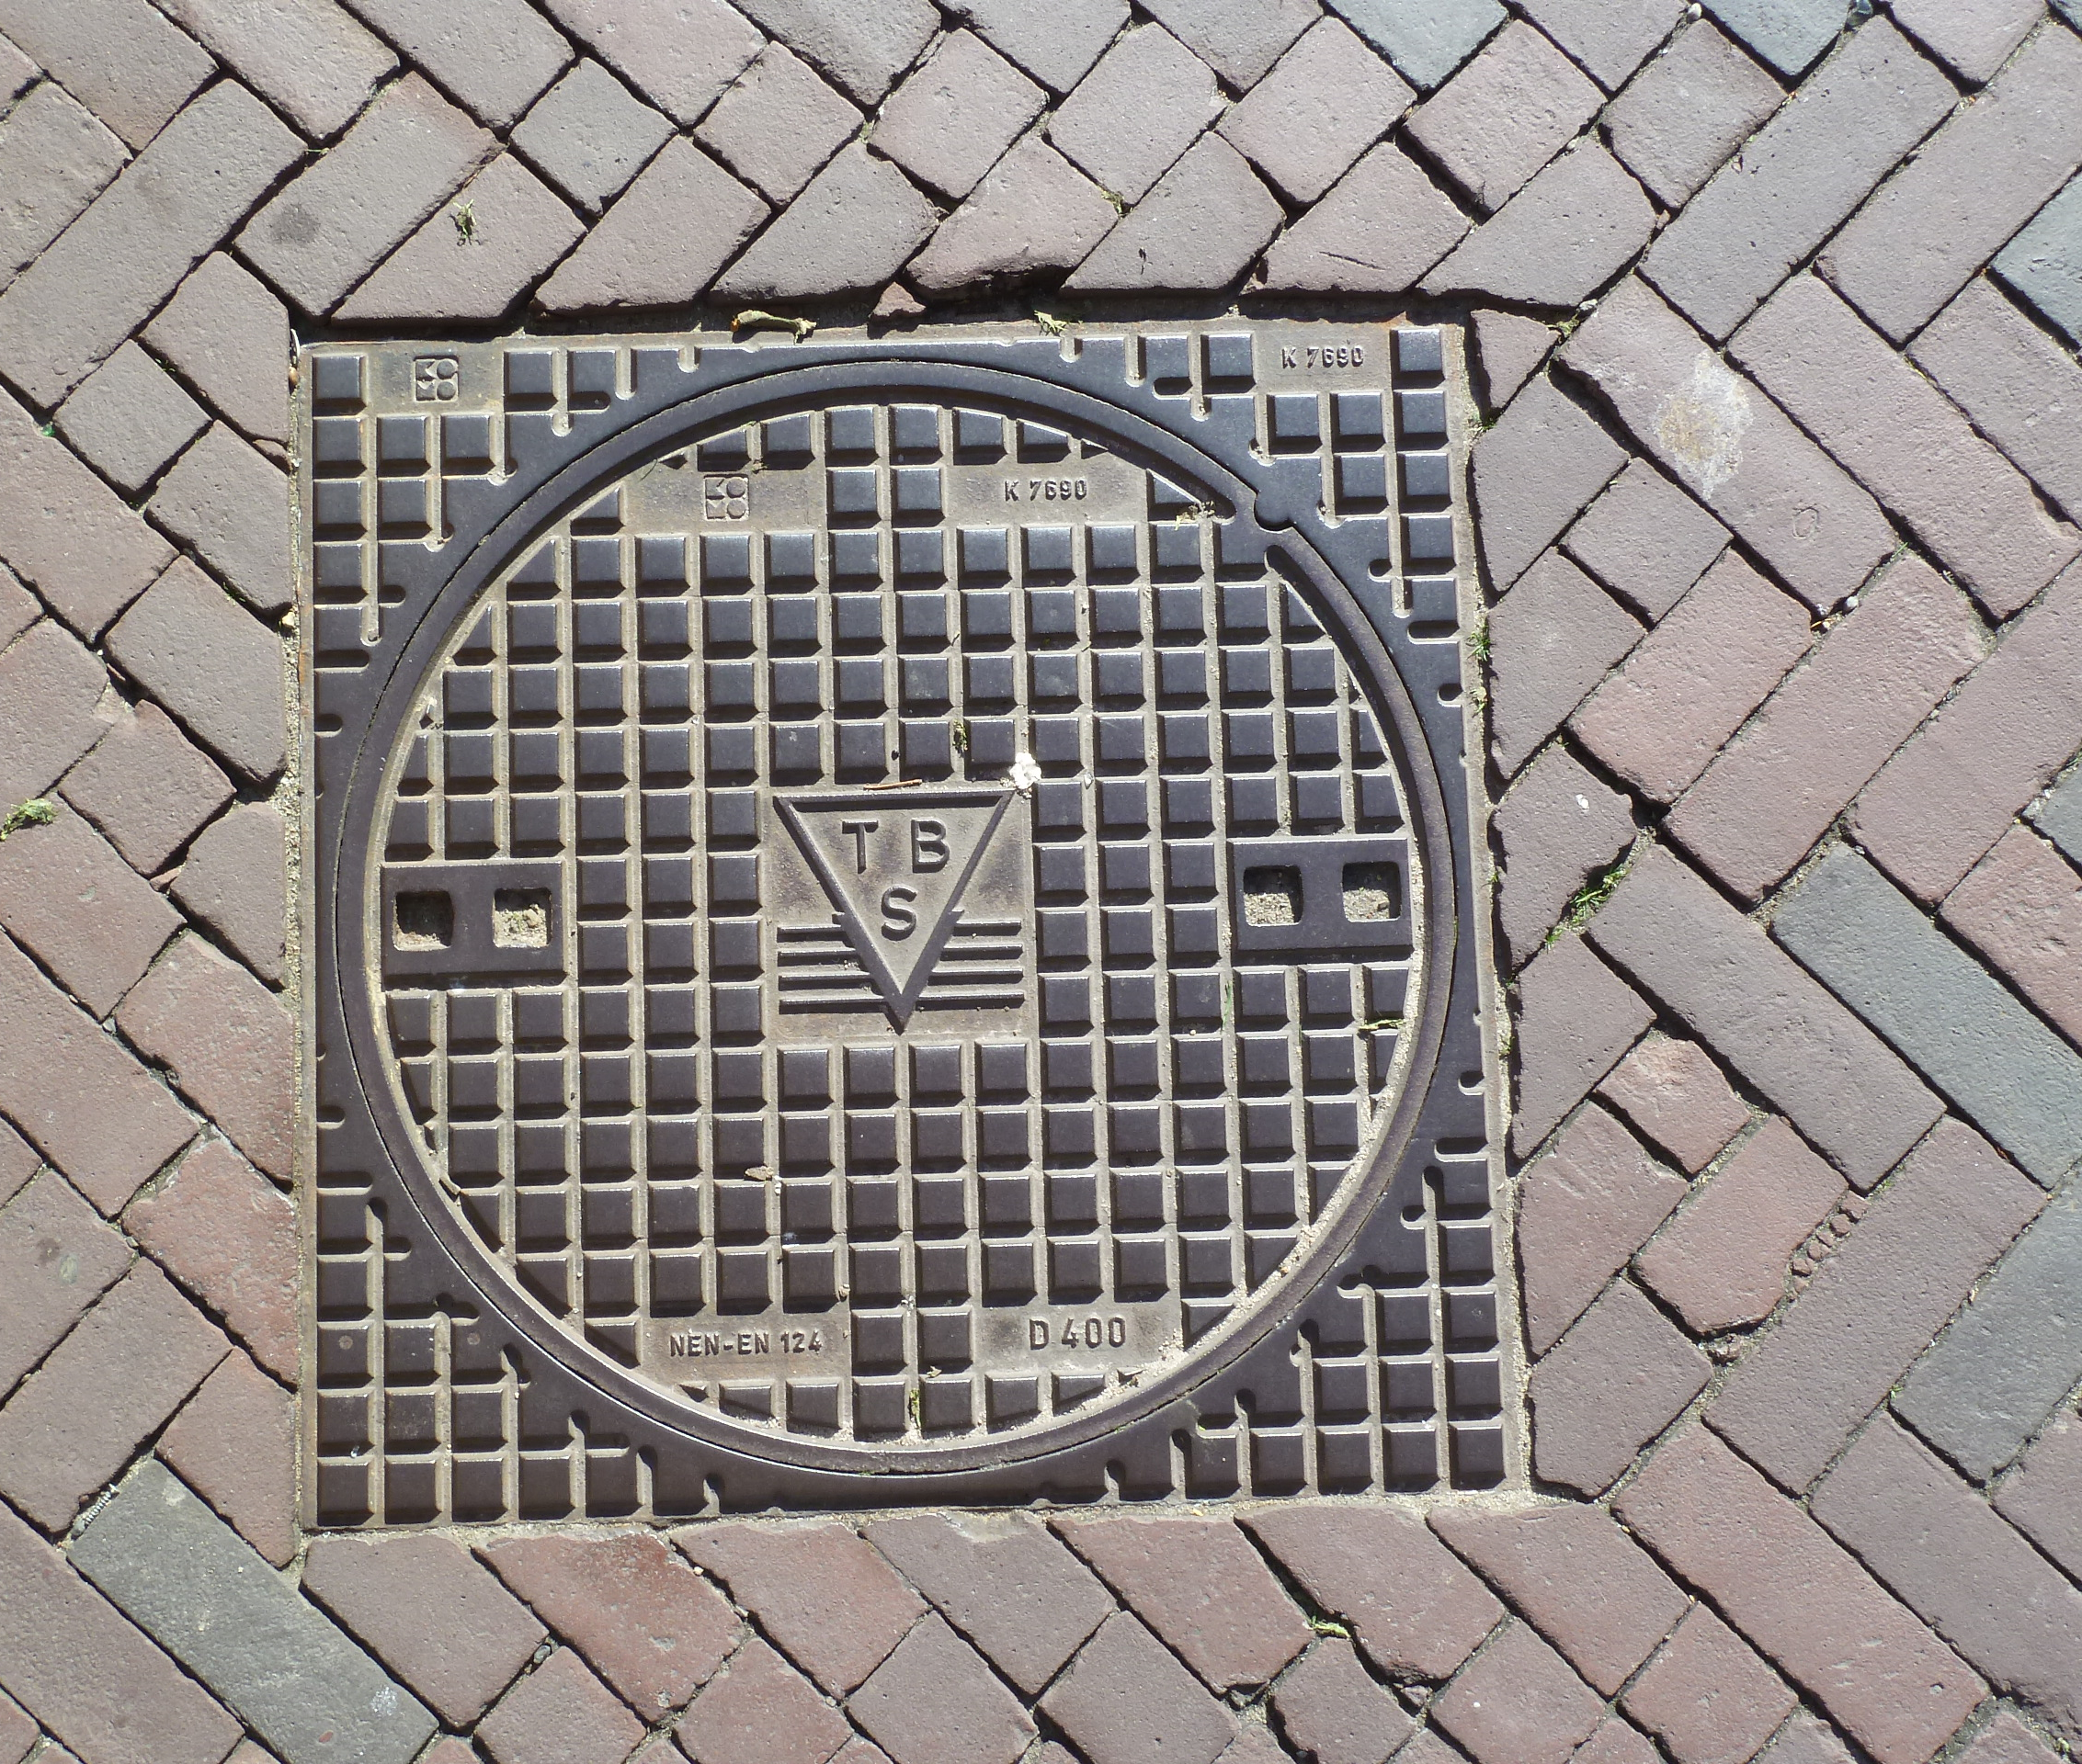
Smart Sewers – Predictive Maintenance
Notes:
An example of how we can better control city infrastructure are smart sewage systems. By analysing water flow patterns coming from sensors, one can assess whether pipes are leaking or near breaking point. This so-called predictive maintenance and can prevent calamities and save money.

Slide 11
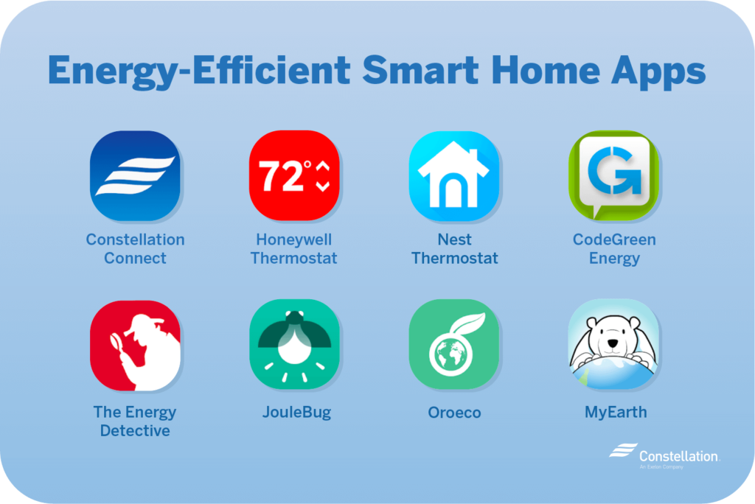
Smart Citizens – Responsible behaviour
Notes:
Smart energy meters and energy management systems are a good example of how we can use technology to change our behaviour. Information about actual energy usage has proven to be a good stimulus to reduce our energy consumption.

Slide 12
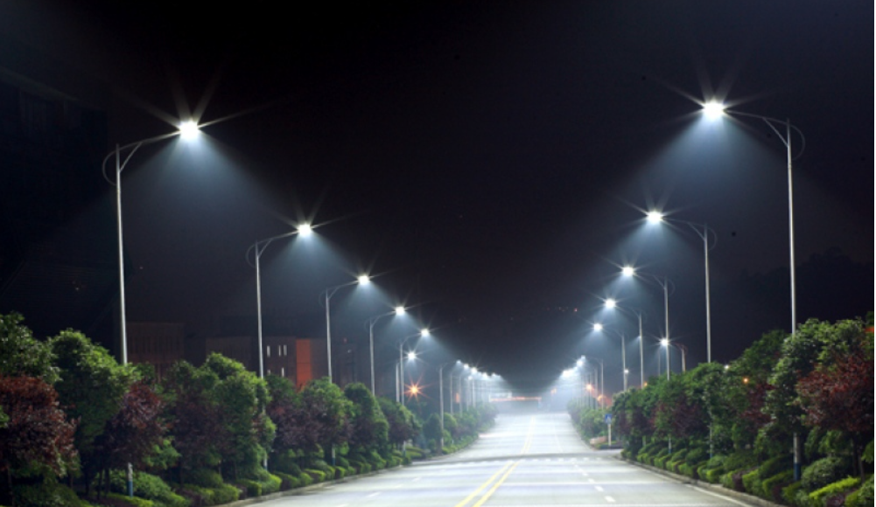
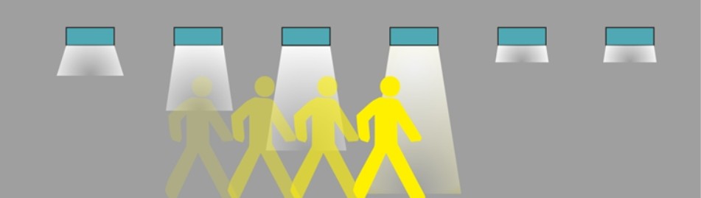
Smart Lighting – Adaptive Systems
http://www.ledinside.com/products/2013/3/20130315_apacoe
http://www.richmond-news.com/led-streetlights-become-more-feasible-for-city-1.1068801
Notes:
Smart Lighting is an example of how digital technology is used to make a system adaptive. Motion sensors detect if there is traffic, and regulate the amount of light accordingly.

Slide 13
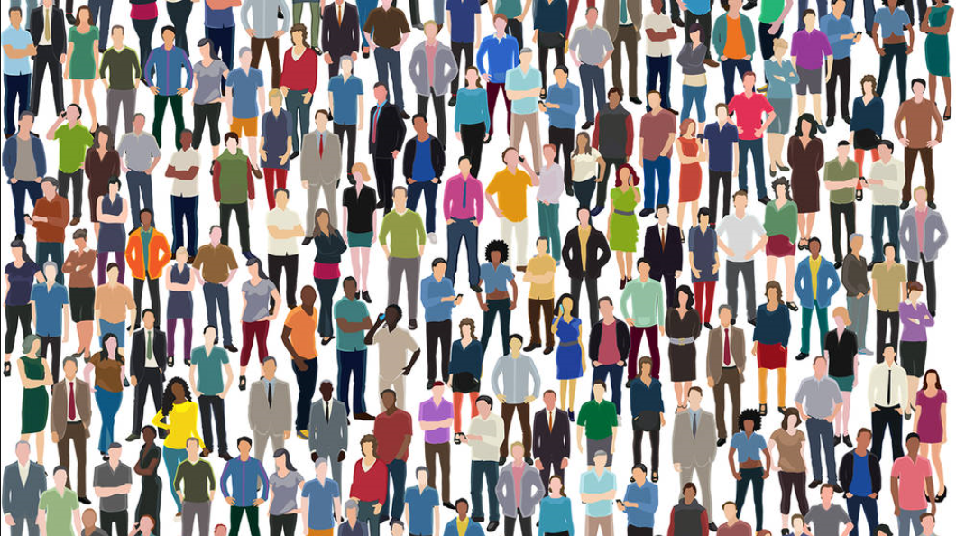
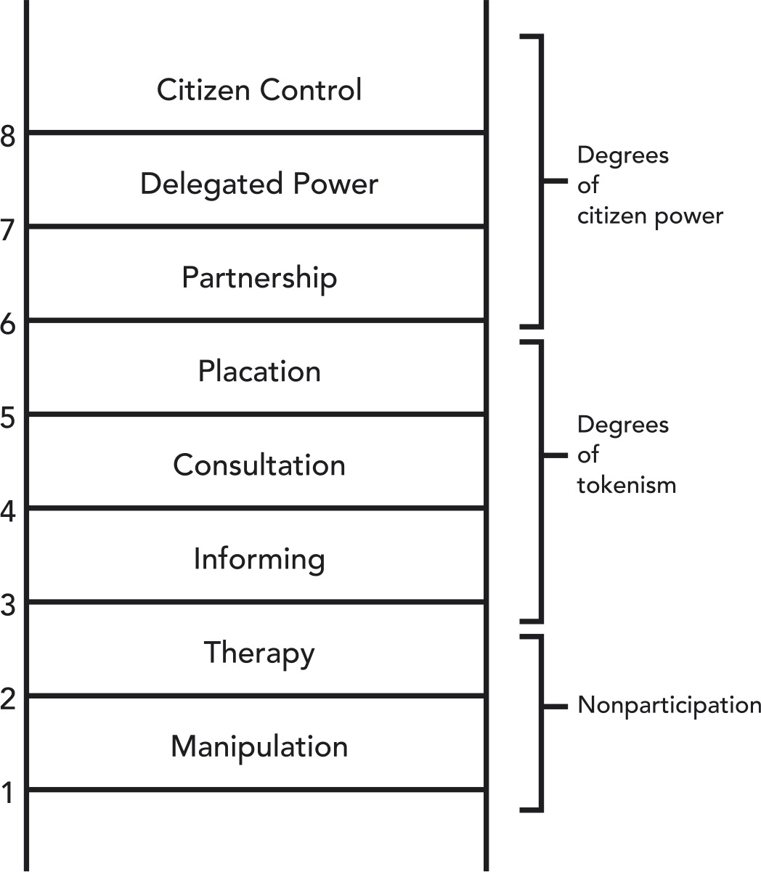
Smart Citizens - Participation
Sherry Arnstein’s Ladder of citizen paricipation (1969)
Notes:
Many local governments understand that “people make the city”. They have thereto adopted Arnstein’s Ladder of participation as a tool to engage their citizens. Yet today, we see a growing gap between citizens that can cope with the speed and complexity of he digital age, and those that can not. To ensure that the latter do not disengage and fall prey to undemocratic forces, governments, institutions and responsible companies, need to act to engage citizens and consumers. Because if we are going to solve grand challenges, we need all of our fellow citizens to be informed, involved and inspired.

Slide 14
Urban Data Platforms for scaling?
Source: Sheombar et al (2020) “Governance, Trust and Smart City Business Models: the Path to Maturity for Urban Data Platforms” | Ruggedised EU project
Notes:
After more than a decade of smart city initiatives, many projects still fail to scale. Lack of standards, legal contracting difficulties, and barriers to work across domains carry some of the blame for this failure. Can the emerging Urban Data Platforms solve these problems? Our research shows that many European cities are currently in the stage of implementing an Urban Data Platform. Of the 88 cities surveyed in 2020, a third already had a platform operational.

Slide 15

AI and
data-driven
solutions
Apps & Services
Digital Twin / Dashboard
Central
Intelligence
Urban Data Platform
Connectivity
Data
Data
Data
Data
Sensors
In field devices / IoT sensors
Citizens as Sensors
Source: Sheombar et al | Ruggedised
Notes:
These platforms have the ability to pool data across siloes, and to pool resources and services for analytics and system development. If well managed, Urban Data Platforms have the potential to increase the reach and scope of smart city projects. By leveraging the network effects of platforms they can help scale the individual projects that feed into or feed off the UDP.

Slide 16
PLATFORM
PURPOSE
L
TRUST
STAKEHOLDER ENGAGEMENT
Services & policies
Economic innovation
Sustainability & resilience
Social innovation & democracy
Citizen Engagement
Triple Helix Collaboration
PLATFORM
GOVERNANCE
Institutional Arrangement
Management
Ownership
Financing
Development strategy
Principles
Openness
Interoperability
Transparency
Trust in UDP Owner, Manager and Financer
PLATFORM
ADOPTION
PLATFORM
USE
VALUE
CREATION
Control
Gatekeeping
Process Control
Shared norms and values
Revenue Model
Number of participants connected to the platform
Number of
Active Users
Data sets
Citizens
Developers etc.
People (social)
Planet
Profit (effi-ciency, new business models)
Data Governance
Mutual Trust between Public and Private sector
PLATFORM
MANAGER
ORGANIZATIONAL
CAPABILITIES
Cross Silo Collaboration
Ecosystem
Nurturing
Change management & Leadership
Data quality Management
Trust in the Platform technology itself
PLATFORM
TECHNICAL
CAPABILITIES
Data Analytics
Privacy Protection
TRIPLE HELIX COLLABORATIVE
EXPERIENCE
Security Maintenance
Business Model Support Tools
16
Source: Sheombar et al | Ruggedised
Notes:
However, managing a UDP is no easy task. In contrast to commercial platforms, Urban Data Platforms are by nature public-private endeavours. This relationship is marked by mutual distrust. Distrust in the government’s ability to cope with technology. Distrust in the private sector, fed by the power of big tech and the risk of vendor lock-in. Our framework for successful value creation by UDPs therefore has trust as a core concept.

Slide 17
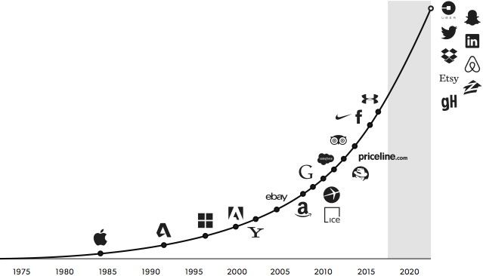
Can Urban Data Platforms do for data what Airbnb, Uber and Takeaway did for rooms, rides and meals?
Source: Moazed 2016
Notes:
Practice will show whether Urban Data Platforms are the catalysts that Smart Cities have been looking for. Much will depend on their proper implementation. And on their ability for scaling and innovation. Our research supports the vision that UDPs are vital infrastructure for cities in this digital age.

Slide 18
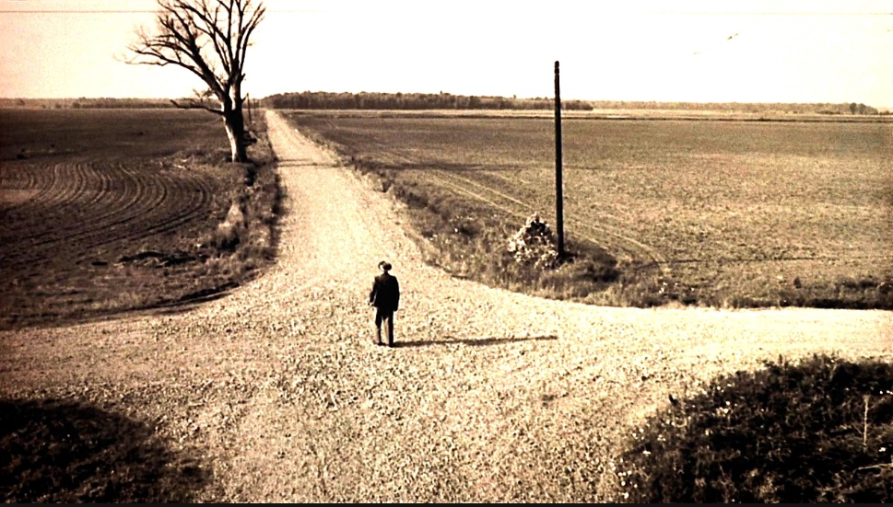
Disengagement and populism
Leaving for Mars …
Climate
change
Singularity and
runaway AI
Democracy besieged by fake news and filter bubbles
Rising
In-equality
Genetic Engineering
Surveillance
Capitalism and
Big Tech
Job displacement
Migration
https://medium.com/indian-thoughts/crossroads-of-life-352525cdad7b
Notes:
Finally, when it comes to the ethics of the use of technology, it seems that we are at a cross road. The unchecked power of big technology companies, the fear of loosing control to Artificial Intelligence, and the toxic influence of social media are real threats, driving some to shun the use of digital technology. But let’s not forget that in democracies, people can control the technology. If we can make our voices heard, we can take the right turn at this cross road, as the citizens of Toronto did.

Slide 19
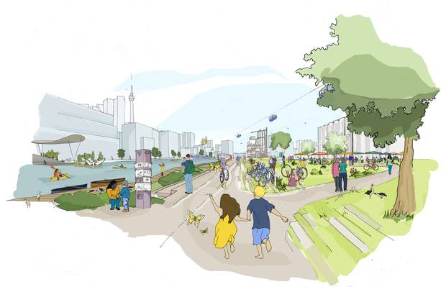

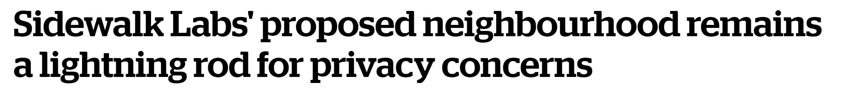
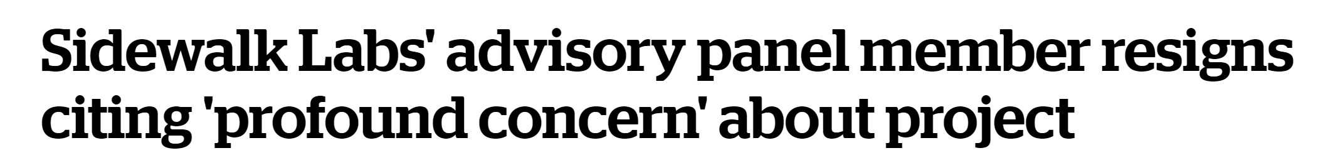
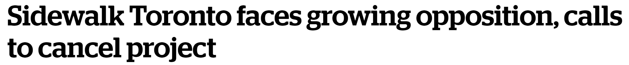
May, 2018
October, 2018
February, 2019
“It is with great personal sadness and disappointment that I share that Sidewalk Labs will no longer pursue the Quayside project”
Daniel Doctoroff, CEO of Sidewalk Labs , Google May 2020
© Sidewalk Labs, CBC News
Notes:
In 2017 Google’s Sidewalk Lab envisioned that Toronto’s Quayside project would be a state-of-the art Smart City project. The result would be a “fundamentally more sustainable and affordable community resulting from innovations in technology and urban design” Last year, Sidewalk Labs abandoned the project, officially due to “unprecedented economic uncertainty”. However, from the very start, the project received fierce criticism from civic society, because of major concerns over privacy and the ownership of citizen and visitor data.
RESOURCES
https://storeys.com/toronto-sidewalk-labs-google-cancelled/
https://www.theglobeandmail.com/canada/toronto/article-sidewalk-labs-quayside-toronto-waterfront-explainer/
Check out this reference about how citizens revolt against big tech
https://www.businessinsider.nl/sidewalk-toronto-google-problems-2019-2?international=true&r=US

Slide 20
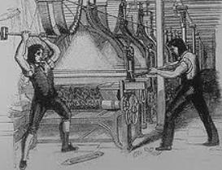
Augmented
Humanity
Luddites smashing machines in early Industrial Age
https://singularityhub.com/2016/01/17/anticipating-your-needs-emotional-intelligence-is-the-key-to-smarter-gadgets/
Notes:
You don’t have to be a Luddite to have genuine concerns about the use of digital technologies by companies, governments and indeed also by citizens on social media. We all have a responsibility to have an open dialogue about the ethics of technology and keep in mind that “technology really does not have a will of its own”. Through the ages it has brought humanity a lot of good. Remember, it was agricultural technology that enabled cities, which some some consider our best invention ever.

Slide 21
Just Imagine ...!
Notes:
The promise of Smart Cities is that they will solve the grand challenges of our time. This is no small promise. You need the right technology, the right governance and the right leadership. With those in place, the promise of smart cities is only limited by our Imagination.

Slide 22
{ End of Presentation }

